Slide 1
ICT Computing Lesson 2:
Computer Hardware

Slide 2
Objectives Lesson 2
1.2.1: Identify internal components of a computer, including case, CPU, RAM, motherboard, power supply, hard drive, expansion cards.
1.2.2: List various computer input devices (including mouse, keyboard, scanner, camera, microphone) and describe their uses.
1.2.3: Identify the types and purposes of specialized input devices, including game controller, stylus, barcode reader, fingerprint scanner, GPS device.
1.2.7: Connect an input device (e.g., mouse, keyboard, mobile phone, camera) and verify proper operation. 1.2.4: List various computer output devices (including monitor, printer, projector, speakers) and describe their uses.
1.2.8: Connect an output device (e.g., printer, monitor, projector) and verify proper operation.
1.2.5: Compare various data storage devices, including flash drive, external hard drive, memory card, discs.
1.2.6: Identify various computer connection ports, including USB, FireWire, parallel, serial, Ethernet (RJ-45), RJ-11, HDMI, audio.

Slide 3
System Unit
Tower where the different components of your desktop computer are housed
Case: houses all of the system unit’s internal components
Protects from:
dust.
static electricity.
moisture.
physical damage.

Slide 4
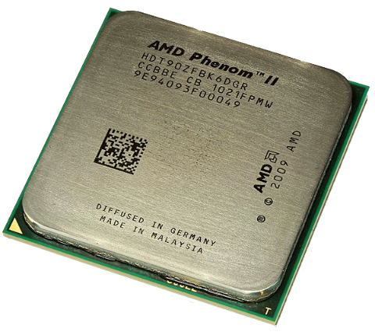
Central Processing Unit (CPU)
Brain of the computer
Does all the processing
Speed measured in hertz (Hz)
Operate at 4 GHz (Gigahertz)

Slide 5
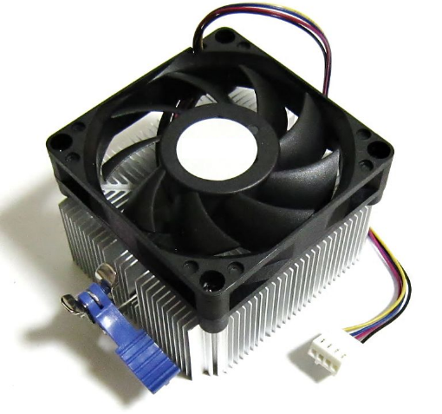
Fan – Heat Sink
Cool the CPU

Slide 6
Random Access Memory (RAM)
Memory chips that are stored on your computer’s motherboard
Stores data being processed by the CPU
Temporary memory
Like your desktop
The more RAM, the faster your computer can run and the more programs that can be opened at once (multi-tasking
Measured in bytes
Cost less than CPU

Slide 7
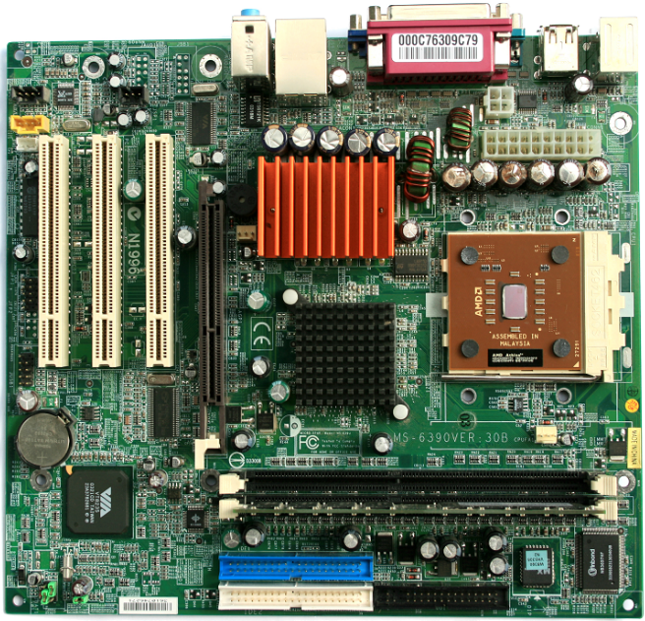
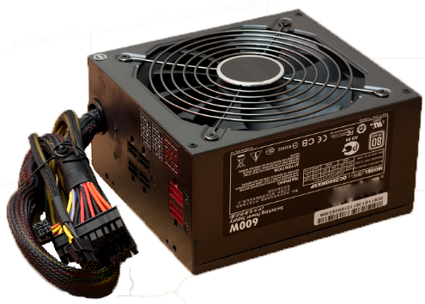
Motherboard – Power Supply
Circuit board inside computer
Connects all devices
Responsible for powering the computer and its parts

Slide 8
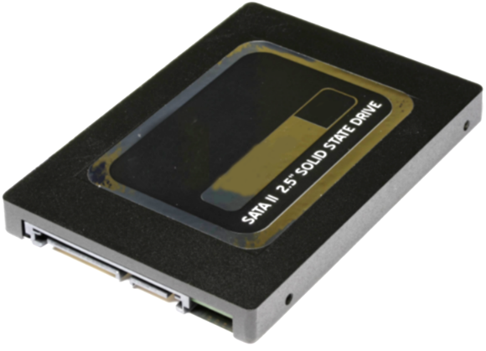
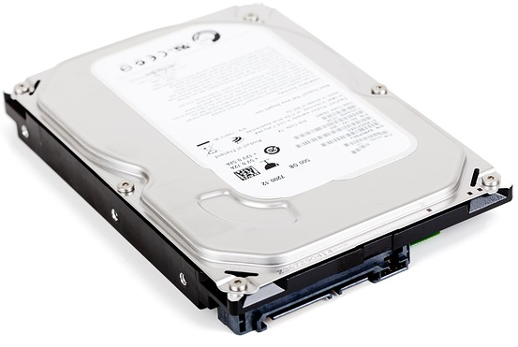
Hard Drive
Stores all the software and data that is not being used currently by the CPU
Known as permanent storage because unlike RAM the hard drive retains all the data stored even when the computer is turned off
Like RAM, hard drive space is measured in bytes
Less expensive than RAM, but slower

Slide 9
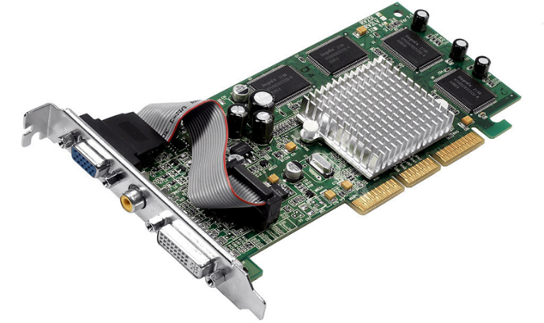
Expansion Cards
Plugged directly into the motherboard’s expansion slots
Accessible from the rear of the system unit
Add functionality (video, network, graphics)

Slide 10
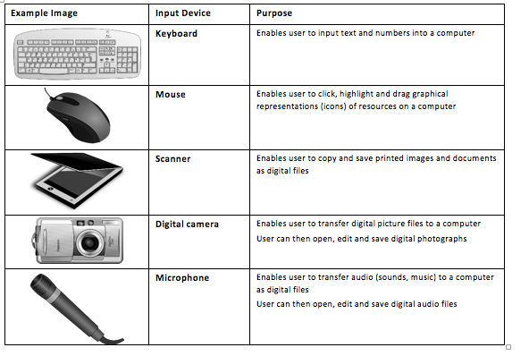
Input Devices
Provide information to the computer

Slide 11
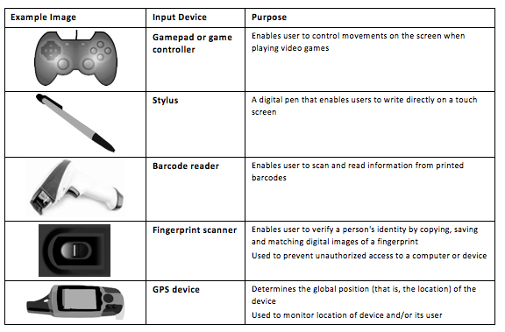
Specialized Input Devices

Slide 12
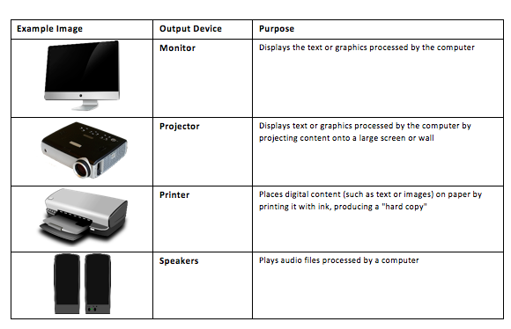
Output Devices
Displays or produces data that has been processed by the computer

Slide 13
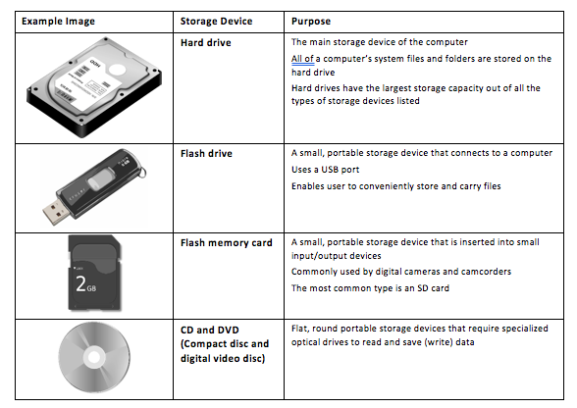
Data Storage

Slide 14
Input / Output Devices
Provide connectivity for external computer components accessing the system unit

Slide 15
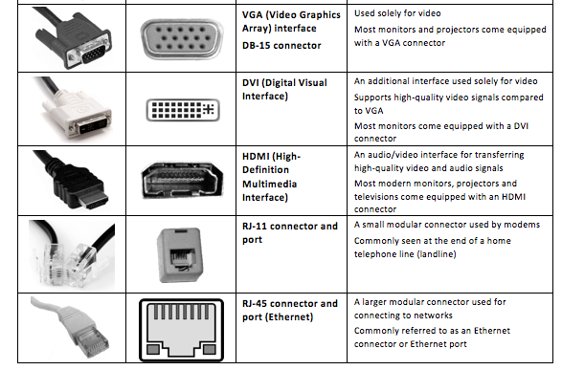
Input / Output Devices

